Slide 1
PROJECT REVIEW
PANEL PRESENTATION
NAME – JEET JAYESH JAIN
© Copyright Reliance Retail Limited. All rights reserved. Unauthorized copying or transmission strictly prohibited. For training purposes only.

Slide 2


PROJECT DESCRIPTION & OBJECTIVE
Project Title: Researching and Enhancing TSP Solutions
Objective:
- Solve the classical Traveling Salesman Problem (TSP) efficiently
- Extend TSP to support multiple vehicles
- Explore metaheuristic techniques like Simulated Annealing and Ant Colony Optimization
- Compare performance and outcomes with known benchmarks

Slide 3
PROJECT METHODOLOGY / WORKING
Implemented Christofides algorithm for near-optimal TSP paths
Extended Christofides to support 4 vehicles starting and ending at depot
Developed node-partitioning logic for vehicle assignment
Researched and tested Simulated Annealing and Ant Colony Optimization
Conducted performance comparisons among the techniques

Slide 4

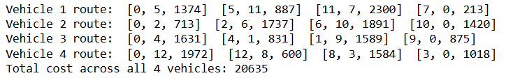
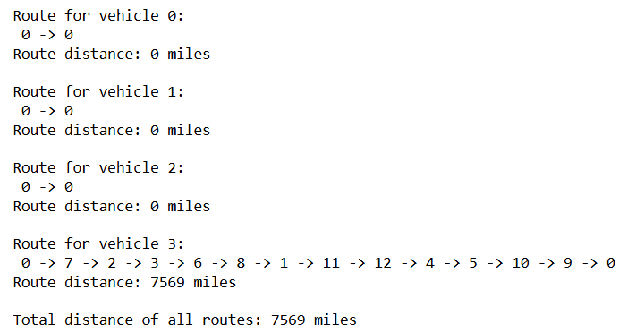
PROJECT OUTCOME / RESULT
My TSP Solution for single vehicle:
My solution for 1 vehicle using multiple vehicle code:
OR Tools Solution for single vehicle:
My solution for multiple Vehicles: OR Tools solution for Multiple Vehicles:

Slide 5
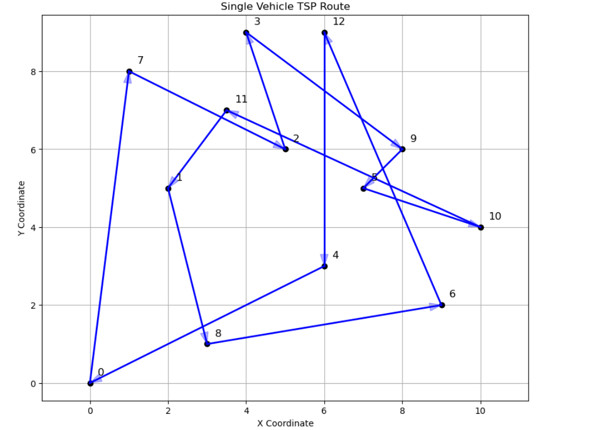
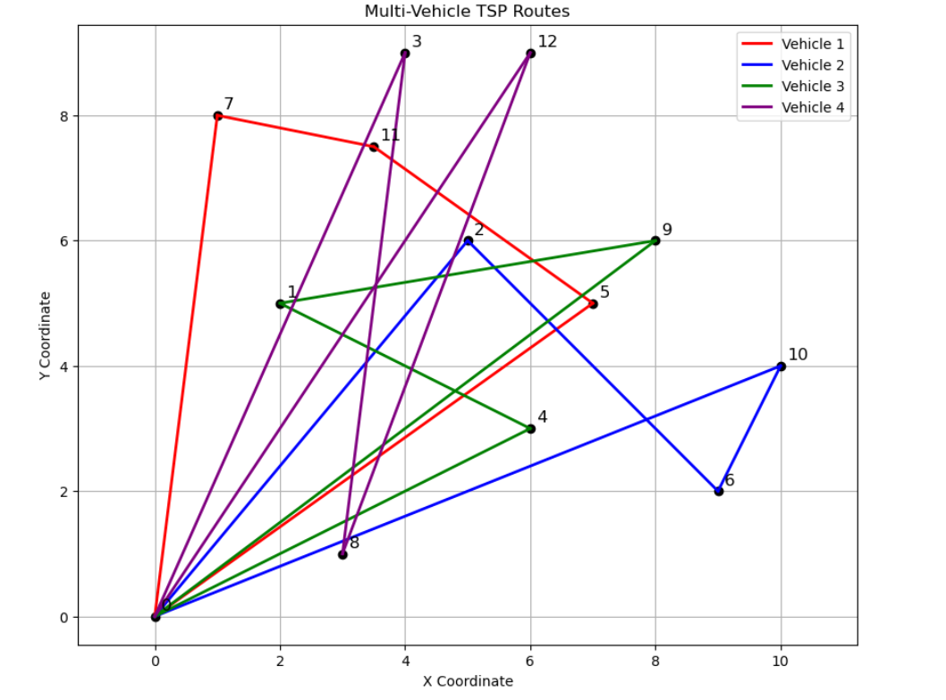
PROJECT OUTCOME / RESULT

Slide 6
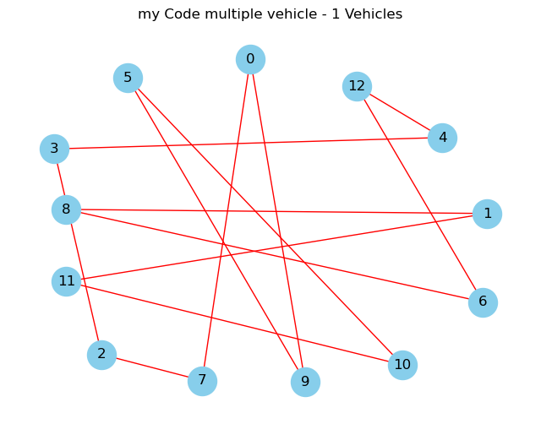
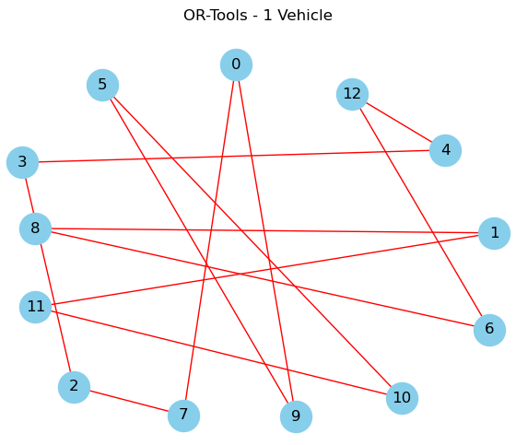
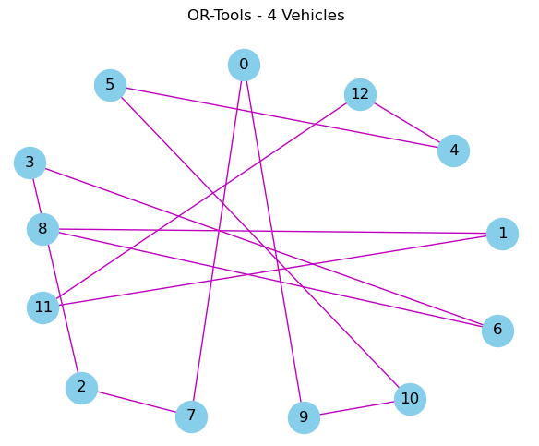
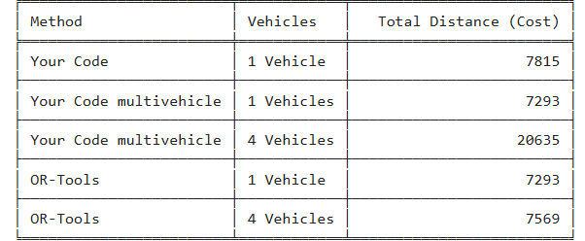
PROJECT OUTCOME / RESULT

Slide 7
RECOMMENDATION
Feature | OR-Tools Code | My Code
Multiple vehicles | ✅ Supported | ✅ Supported (manually splits cities across vehicles)
Type of algorithm | Constraint-based optimization | Heuristic + Approximation
Flexibility for constraints | Very high (can add capacity, time windows, etc.) | Limited, unless manually added
Quality of solution | Generally very good, close to optimal | Approximate, depends on graph structure & steps
Route balancing | ❌ May give empty routes for some vehicles | ✅ Tries to balance nodes round-robin
Depot return | ✅ Vehicles start and end at depot | ✅ manually enforce start/end at depot
Risk of bugs | Low | Medium (errors in remapping or slicing)

Slide 8
KEY LEARNINGS
Gained deep understanding of TSP and approximation algorithms
Understood trade-offs in time vs. accuracy among algorithms
Learned how to implement metaheuristics practically
Applied data structures like graphs, and matchings effectively

Slide 9
HITS & MISSES
HITS:
Successfully implemented Christofides & multi-vehicle extension
Strong learning of real-world constraints in routing problems
MISSES:
The custom algorithm I initially developed worked only for a small number of nodes
When scaled to 13 nodes, it failed to produce valid results
As a result, I had to switch to a more reliable approach using Kruskal’s algorithm for building the Minimum Spanning Tree

Slide 10
OVERALL EXPERIENCE
Strengthened problem-solving and algorithmic thinking
Learned practical aspects of combinatorial optimization
Encouraged to explore AI-based solvers and hybrid methods in logistics

Slide 11

THANK YOU
© Copyright Reliance Retail Limited. All rights reserved. Unauthorized copying or transmission strictly prohibited. For training purposes only.

